Slide 1
Using Vases as an Introduction to Graphing
Presented by: Anthony Cordero

Slide 2
Goal and Objectives of this activity
Goal:
The student will gain a deeper understanding of graphing by using different shapes of vases.
Objectives:
Given a hands-on-activity:
Students will graph a relationship between the amount of water in a vase, and the height of the vase.
Students will use measuring tools to measure the height of a vase, and the amount of water in a vase using a measuring cup.
Students will distinguish which variable goes on which axes.
Students will create a table of values indicating the amount of water and the height of the vase.

Slide 3
Some Definitions to Keep in Mind.
Function
The Graph of a Function
A relationship or expression involving one or more variables.
The graph of a function is the set of all points in the plane of the form (x, f(x))

Slide 4
Materials needed
Ruler
A vase
A water bottle
A measuring cup
A marker
The worksheet, which will use a table and grid

Slide 5
Steps to take into consideration
Get into groups of 4.
Create marks on the vase. Do increments of 1 inch.
Label your variables on the table. Determine which goes on the x-axis, and which goes on the y-axis.
Start measuring! Use the measuring cup and record your data as you move to every inch.
Create your grid. Label your x and y-axis

Slide 6
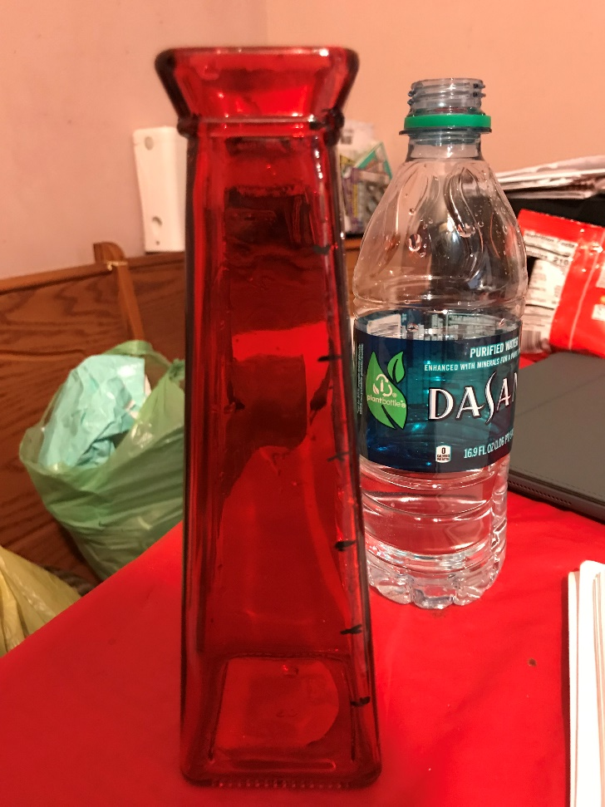
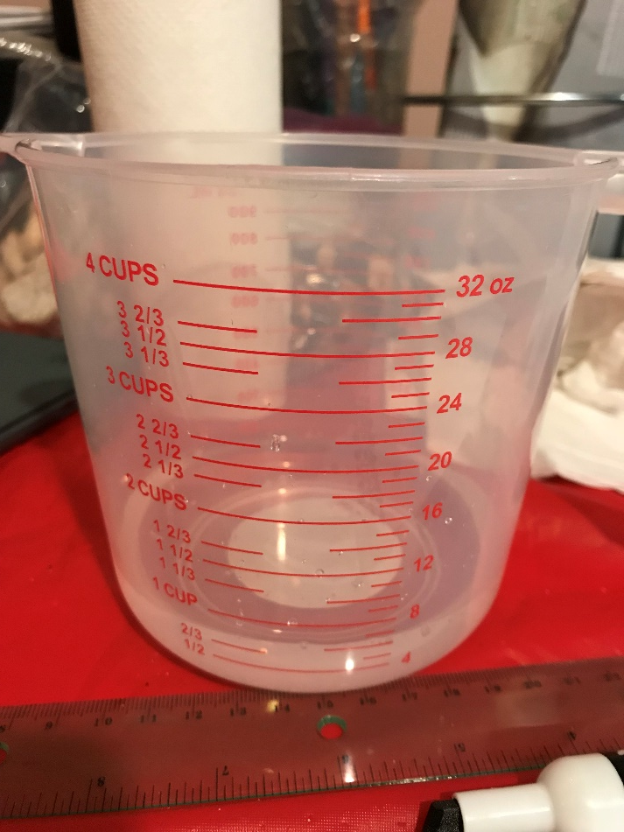
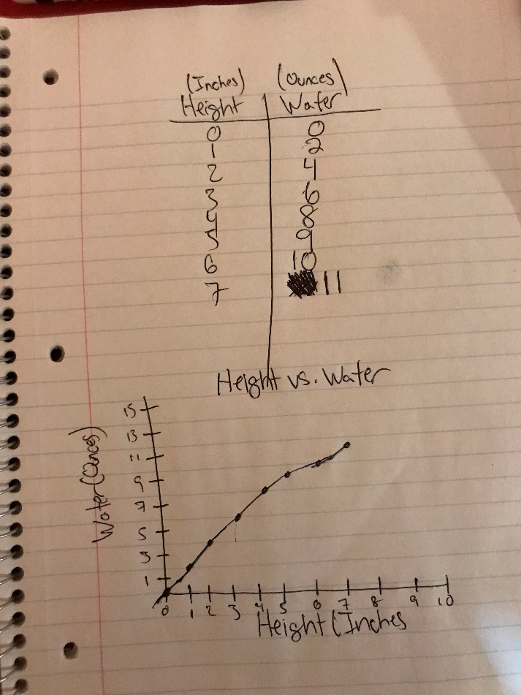
Example

Slide 7
Questions to think about after completing the graph
Based on your graph, find the slope of the line.
What is the height of your vase?
What are your variables in respect to the x and y-axis?
If your vase was in the same shape, but at a longer height, would you be able to predict how much water will be in a given height?
What if you had less water? If you only had say half of the amount you were given, what would be the maximum height you can get to in your vase?

Slide 8
Suggestions for this project
Have smaller measuring cups that can measure in milliliters. This can provide us with more precise measurements.
Have graph paper for students to use rather than using a grid.
You can use other substances besides water. (i.e. M&M’s, Skittles, etc.)

Slide 9
Works Cited
http://dl.uncw.edu/digilib/Mathematics/Algebra/mat111hb/functions/graphs/graphs.html

